Slide 1

Predicting the success of Starbucks locations
By: Alexis raymond

Slide 2
AGENDA
Introduction
Data
Exploratory Data Analysis
Predictive Modeling
Conclusion

Slide 3
INTRODUCTION
Known for its taste, quality and customer experience, the Starbucks has expanded to over 25,000 locations worldwide in the past 50 years
This project aims to predict whether a Starbucks will be successful based on its location
Being able to predict whether a location will be successful would constitute a huge competitive advantage

Slide 4
Data sources
Sources
Starbucks Locations Worldwide
List of United States cities by population
Foursquare Places API
Limitations
500 quota for free version of Foursquare API
Rating only indicates customer satisfaction

Slide 5
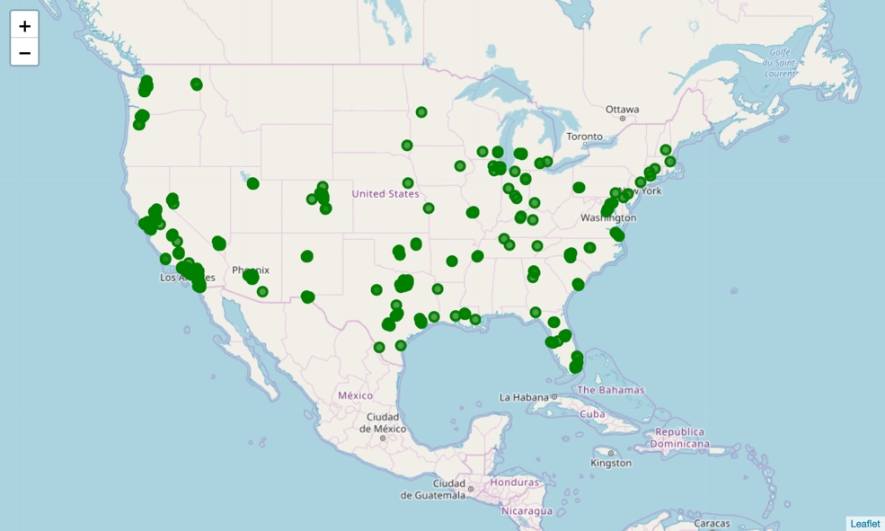
Data Cleaning
Step | Initial | Final | Removed | Reason
US cities | 25,599 | 5,869 | 19,730 | These locations were not in the identified US cities
Nearby venues | 5,869 | 5,866 | 3 | These locations did not have nearby venues in Foursquare
Foursquare ID | 5,866 | 3,807 | 2 2,019 | Request errors Starbucks not in Foursquare
Daily call quota | 3,807 | 500 | 3,307 | API daily call quota of 500 premium calls
Ratings | 500 | 384 | 2 114 | Rating not found Less than 10 ratings

Slide 6
Feature Selection
Feature | Description
Area | Area of the city in which the Starbucks is located (in km²)
Density | Population density of the city in which the Starbucks is located (in population per km²)
Nearby Venues | Categories of venues located in a radius of 500 meters of the Starbucks
Distance to HQ | Distance between the Starbucks and the Starbucks head office in Seattle
Rating | Target variable: Measure of success of the Starbucks

Slide 7
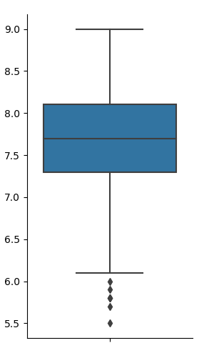
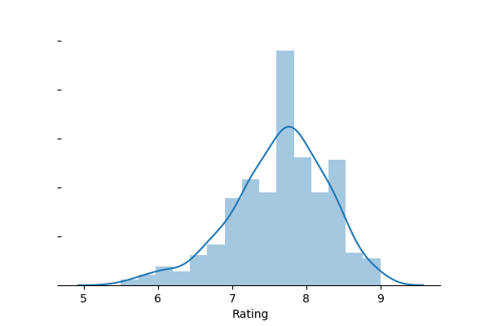
Ratings Analysis
The ratings are normally distributed around the value of 7.75 with only 5 outliers between the values of 5.5 and 6.

Slide 8
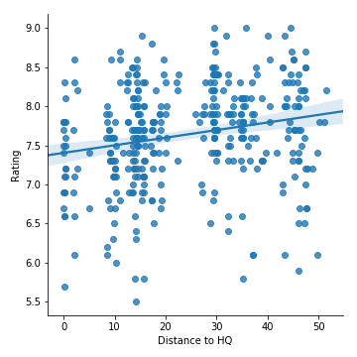
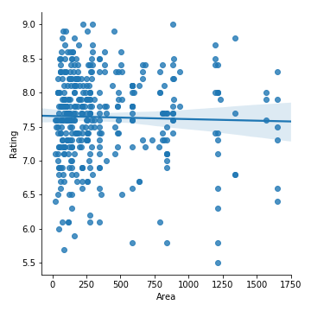
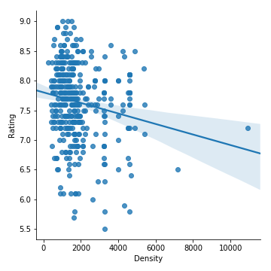
Absence of a correlation
Contrary to our initial hypothesis, there is no correlation between the city in which the Starbucks is located and its rating. This suggests our predictive model will rely heavily on the buildings surrounding the store.

Slide 9
Predictive Modeling
Feature | Coefficient | Feature | Coefficient
Pool Hall | 42.08 | Recreation Center | -43.06
Football Stadium | 29.26 | Beer Bar | -36.62
Garden Center | 28.74 | Auto Dealership | -34.84
Pier | 26.60 | French Restaurant | -31.34
Plaza | 24.07 | Shoe Repair | -29.35
Linear regression model was used as it is the best for predicting quantitative values with a limited dataset
The model was trained using 617 features to predict the rating
The following table shows the 5 features that lead to a high ranking and the 5 that lead to a low ranking

Slide 10
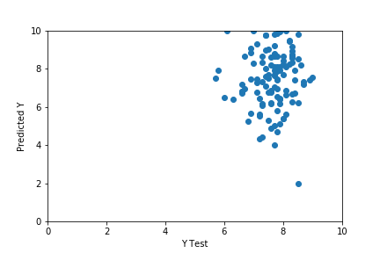
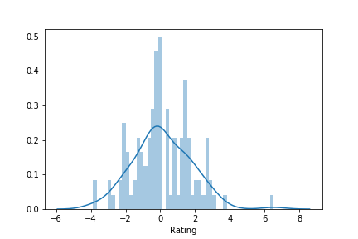
Model Performance
The model contains some outliers but in general, there is a correlation between predicted and real values
No overfitting and performance metrics within acceptable range
Residuals distributed normally around 0 = no bias
Metric name | Value
Mean Absolute Error | 1.28
Mean Squared Error | 2.80
Root Mean Squared Error | 1.67

Slide 11
Conclusion
The result of this research was that the only good indicators of whether a Starbucks will have a good customer satisfaction rate is the type of buidings around it
Executives should use the results outlined above lightly as they do not show a complete picture of how successful the store really is
Future Directions
More Data: gather data from all around the world, analyzing ratings from more than one source and collecting more demographic data
Definition of Success: include financial data about the store vs just its rating

